Slide 1

PIXELS
Interactive WebApp for Image Processing
Lokesh Balani (20173073)
Abhishek Tyagi (20173067)
November 29, 2018

Slide 2
Interactive GUI
Minimalist Design
Support for Image Drag & Drop
Image Upload from Local Computer
Downloadable Images
Accessible Image & Module Info
Option Settings for Processing Techniques
Modular
Significant development for ease-of-extension
Lecture Companion
Intermediate Iteration Steps Output
Do It Yourself (Hands - On)
Python Image Processing Lib Support
PIXELS
Project Pivot

Slide 3
What Are We Building?
Basic Platform
HTTP Server, Django, Restful API
Basic Framework and Services
Python Library Integration, Web
Interactivity, Customization Options
Configurable Front-End Code
Browser Support
Google Chrome & Mozilla Firefox
Basic Image Processing Techniques
Instructors’ Lecture Companion
“Coding for Image-Processing Techniques”
Documentation
PIXELS
Overview

Slide 4
Basic Django Platform Setup
UX & Design for the Web Application
Developing Front End (CSS/JS)
Image Drag & Drop, Select Zoom Support
Back End Support for Python Libraries
Implementing Image Processing Techniques
Support for Configurable Options
Division of View
Instructors’ Lecture Companion
DIY (Do It Yourself)
PIXELS
Milestones

Slide 5
Sphere of Development
Django Settings
Image Processing Module
Web Page using Django Templates
Markup
Front End Code (CSS/JS)
Documentation

Slide 6
Sphere of Development
Django Settings
Image Processing Module
Web Page using Django Templates
Markup
Front End Code (CSS/JS)
Documentation
Django & Python Back End
Front End Styling and Interactivity

Slide 7
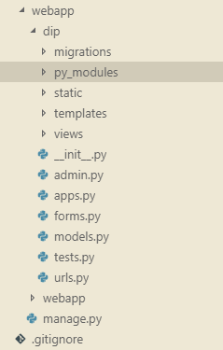
Application Architecture and Development
Folder structure
Python Modules
Folder Path: /webapp/dip/py_modules
Purpose: Python Implementation of Image Processing Modules
Static Assets
Folder Path: /webapp/dip/static
Purpose: Static assets like CSS, JS for the website
Django Templates
Folder Path: /webapp/dip/templates
Purpose: Web Page Django Templates for the Modules
Django Views
Folder Path: /webapp/dip/views
Purpose: View controller logic python scripts for Modules
Django App URL Settings
Folder Path: /webapp/dip/urls.py
Purpose: URL settings and view bindings for the Modules

Slide 8
Image Processing Techniques Inventory
Histograms
Histogram Plot
Histogram Equalization
Image Thresholding
Global Thresholding
Adaptive Thresholding
Sharpening Spatial Filters
Sobel Derivatives
Laplacian Derivatives
Smoothing Spatial Filters
Averaging Filter
Gaussian Filter
Median Filter
Bilateral Filter
Morphological Transformations
Connected Components
Erosion
Dilation
Opening
Closing

Slide 9
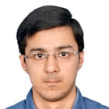
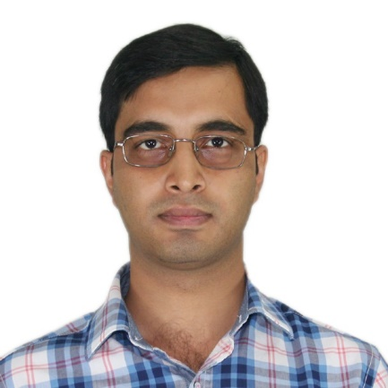
Lokesh Balani
UI Lead, Virtusa
PGSSP, IIIT-H
PIXELS
Abhishek Tyagi
Team Members
Principal Analyst, D.E.Shaw & Co
PGSSP, IIIT-H
GitHub Repository
https://github.com/lokeshbalani/pixels

Slide 10
PIXELS: Contribution
Lokesh
Basic Django Platform Setup
UX & Design for the Web Application
Developing Front End (CSS/JS)
Support for Configurable Options
Image Drag/Drop, Select Zoom Support
Division of View - Instructors’ Lecture Companion, DIY (Do It Yourself)
Implementing Image Processing Techniques
Histogram
Connected Components Algorithms -Python to JavaScript
Abhishek
UX & Design for the Web Application
Back End Support for Python Libraries
Implementing Image Processing Techniques
Morphological
Smoothing Spatial Filters
Edge Detection Filters (Laplacian & Sobel)
Image Thresholding
Connected Components Algorithm Development in Python - First Pass & Second Pass with Union Find

Slide 11
PIXELS Let’s See Some Action

Slide 12
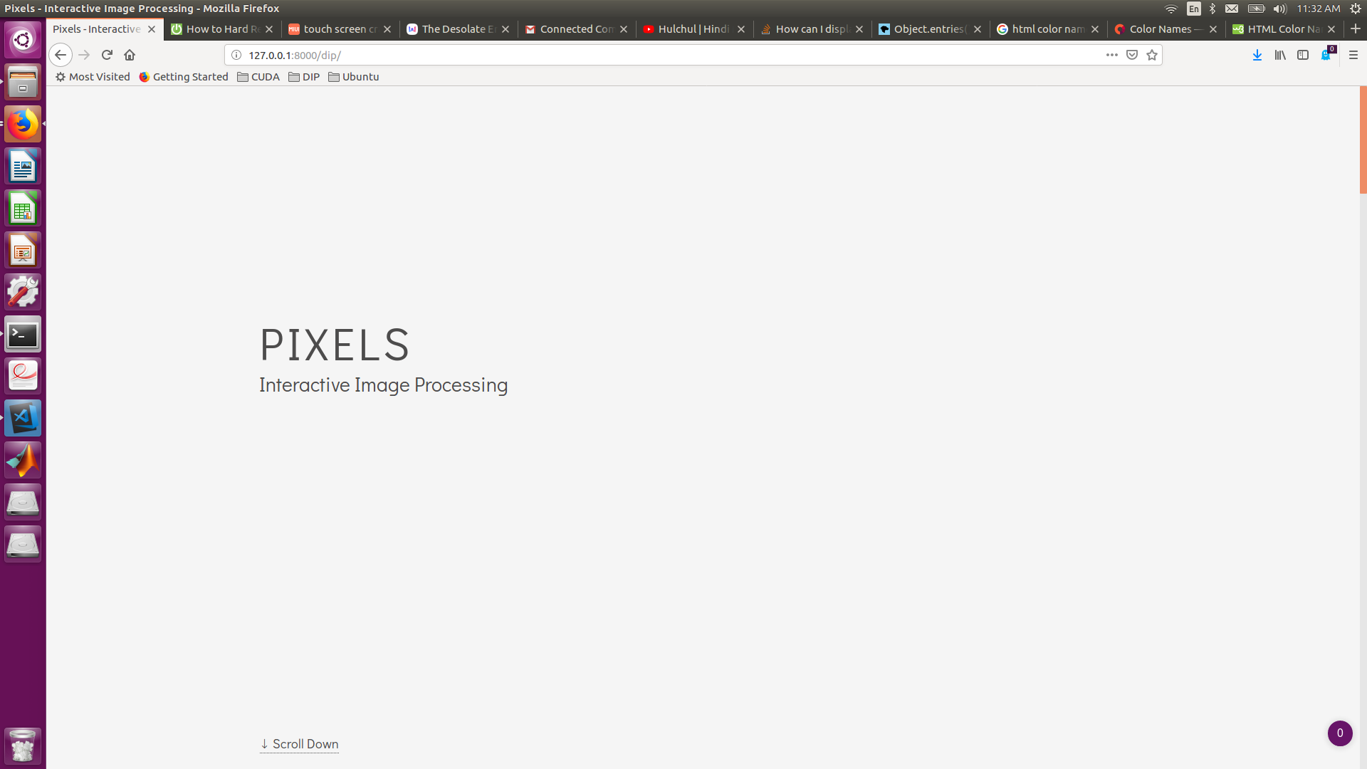
PIXELS: Home Page

Slide 13
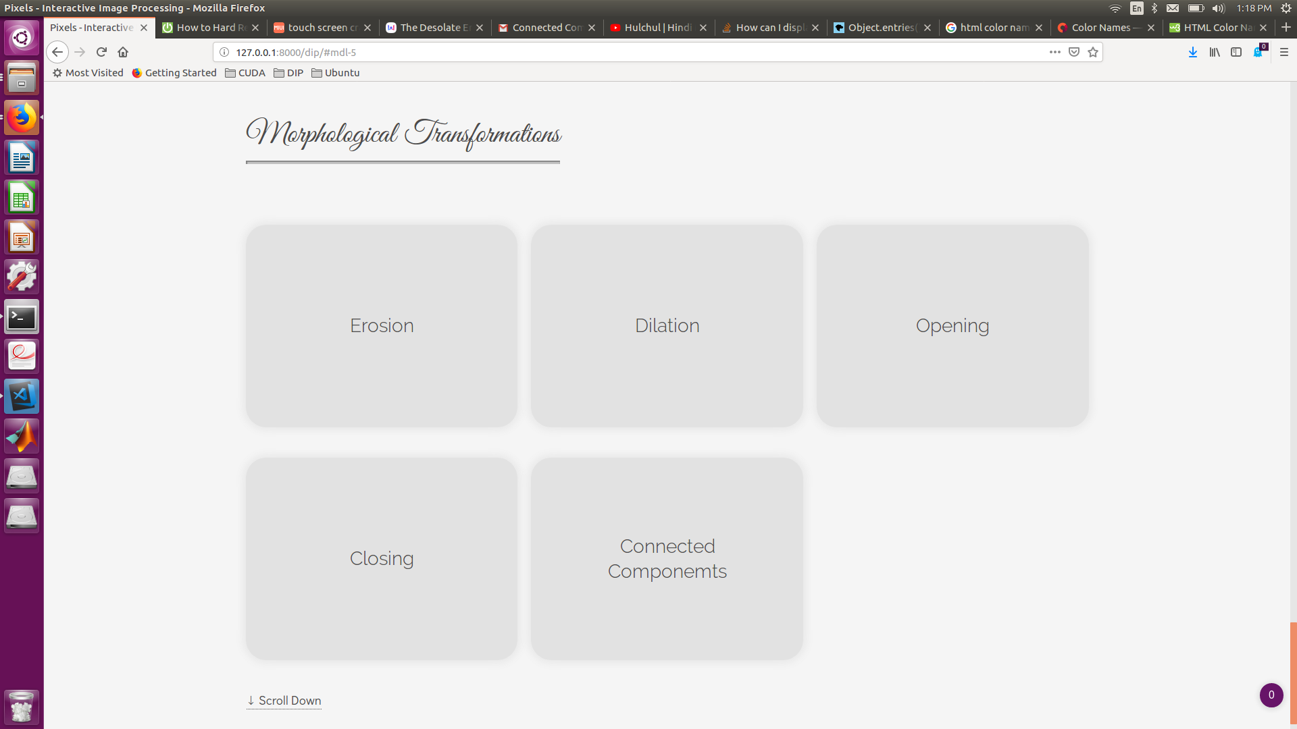
HOME PAGE: Module Section

Slide 14
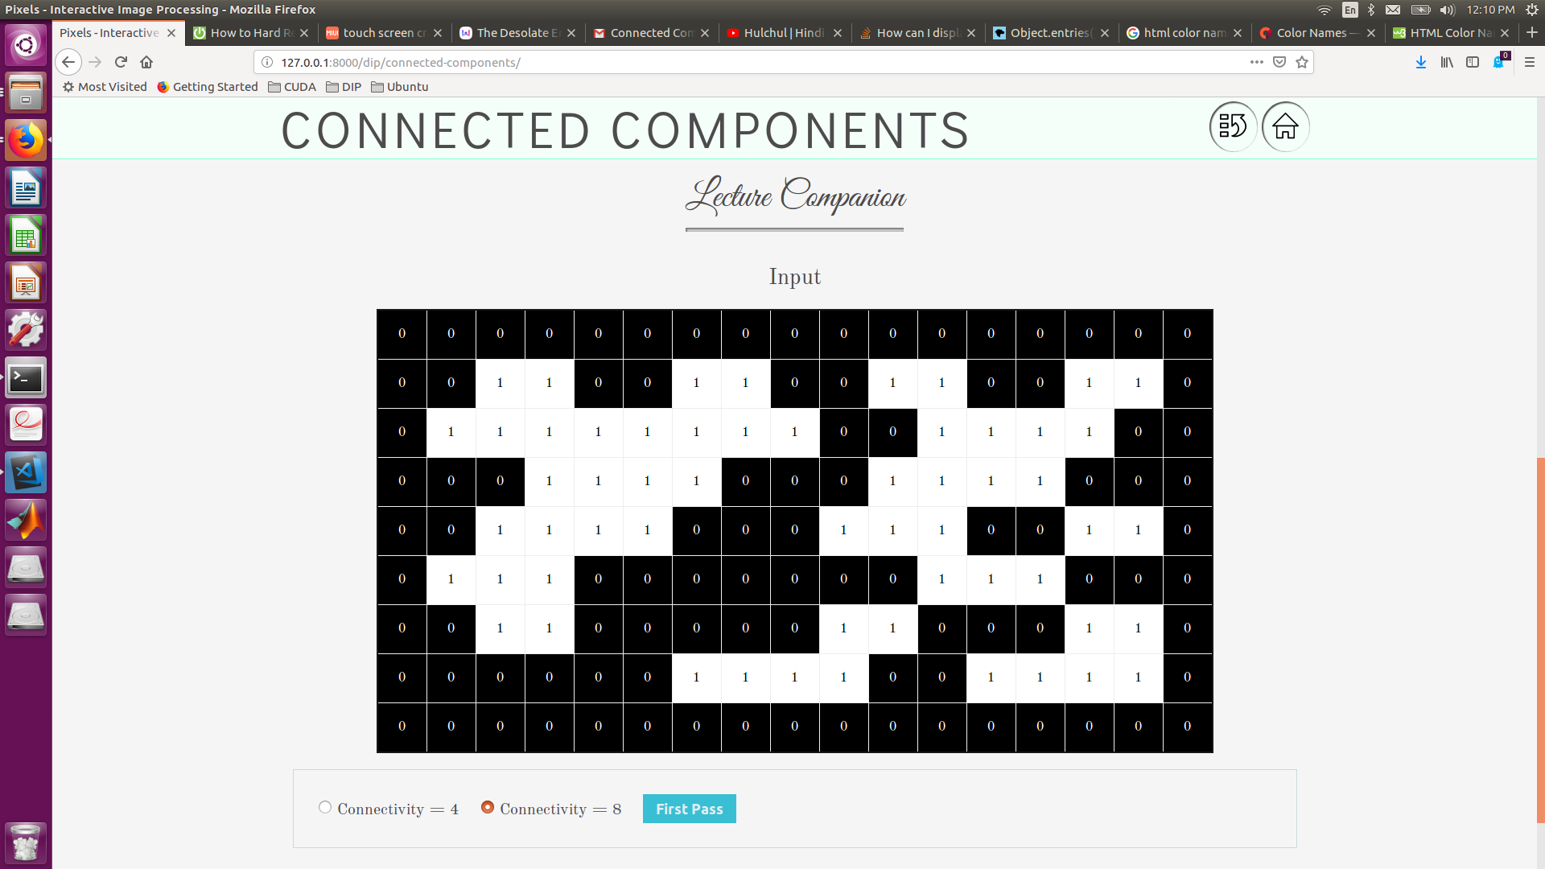
PIXELS: Connected Components

Slide 15
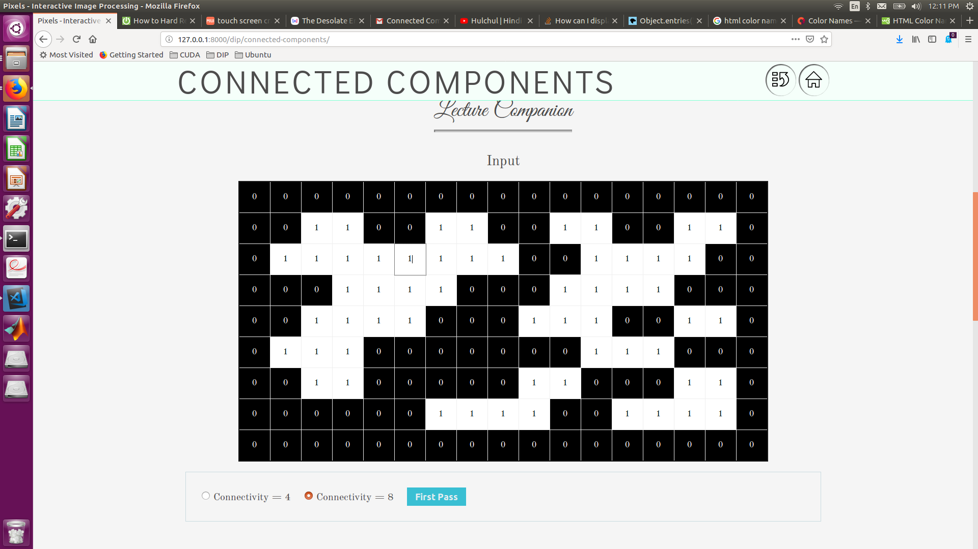
CONNECTED COMPONENTS: Editable Cells

Slide 16
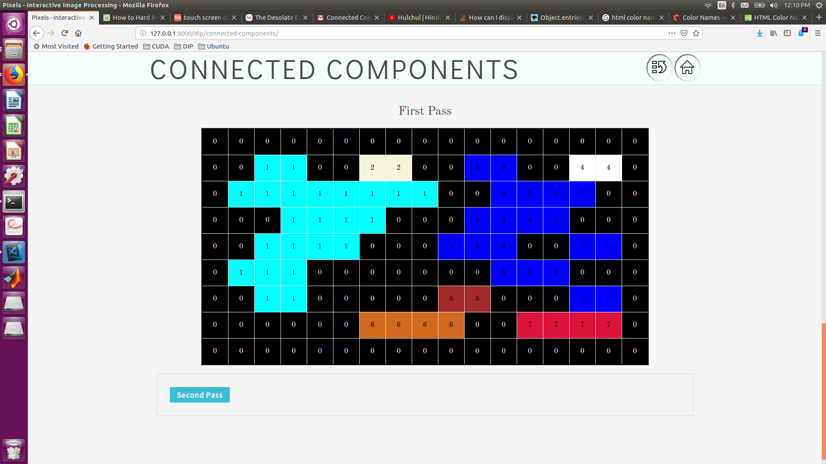
CONNECTED COMPONENTS: First Pass

Slide 17
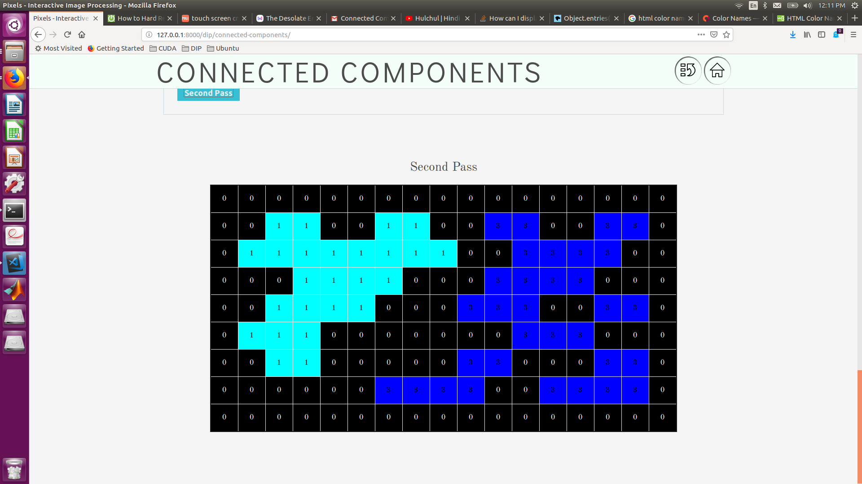
CONNECTED COMPONENTS: Second Pass

Slide 18
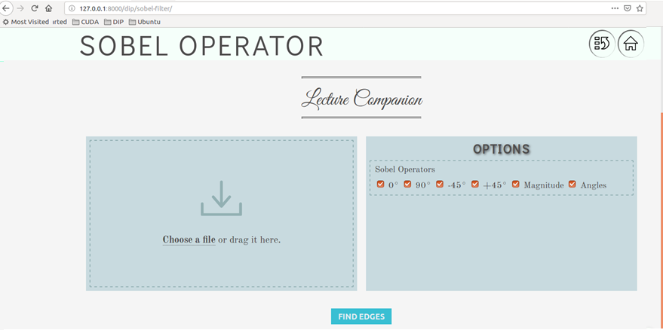
PIXELS: Sobel Filter

Slide 19
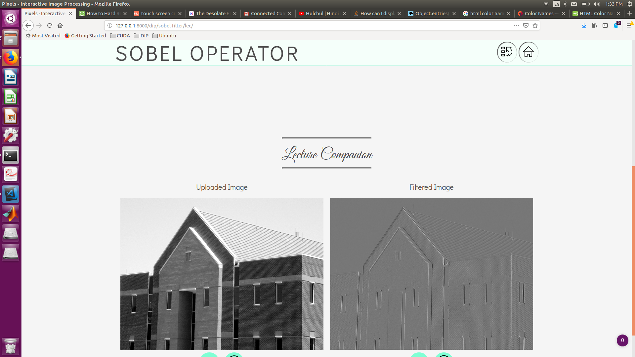
PIXELS: Sobel Filter
Horizontal: 0 Degree
Vertical: 90 Degree

Slide 20
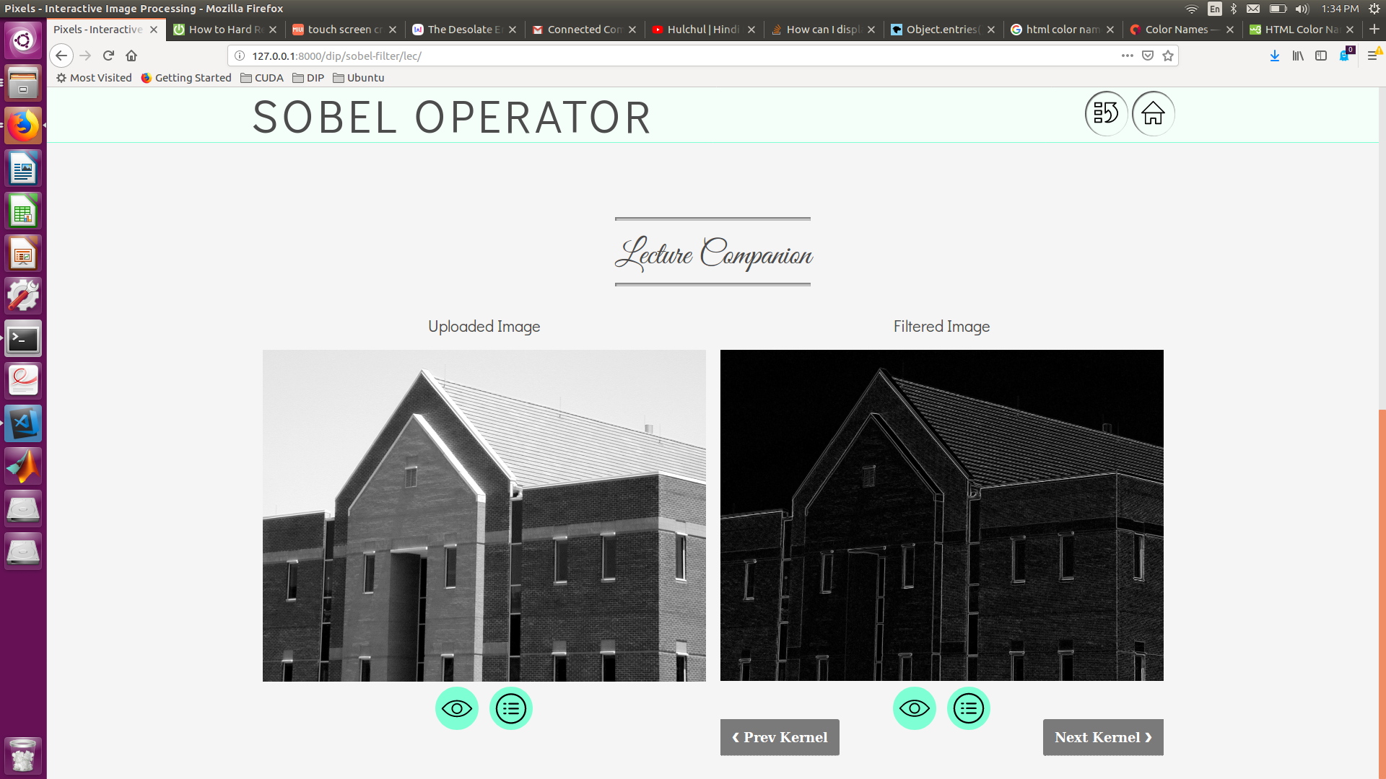
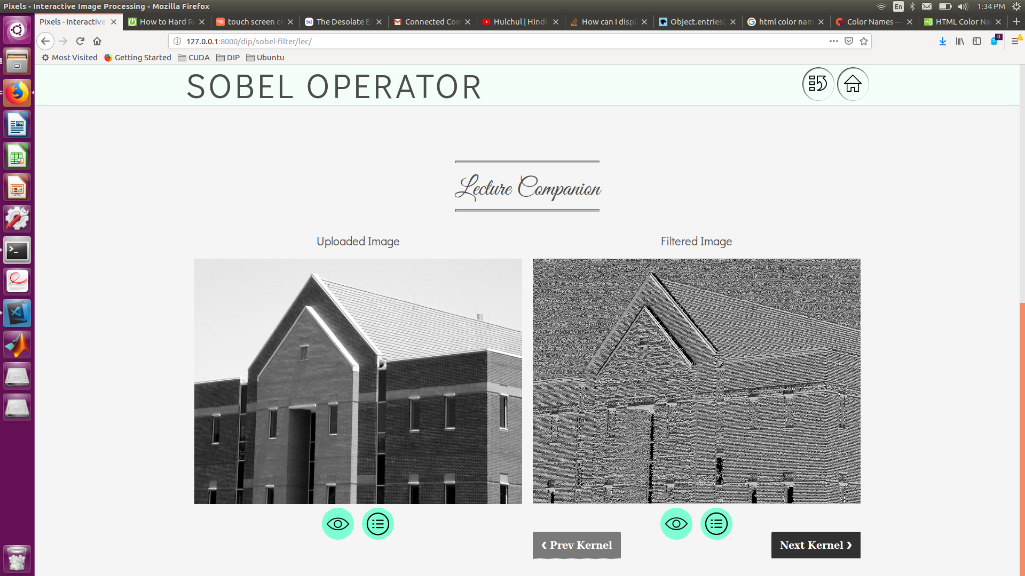
SOBEL: Magnitude & Angle

Slide 21
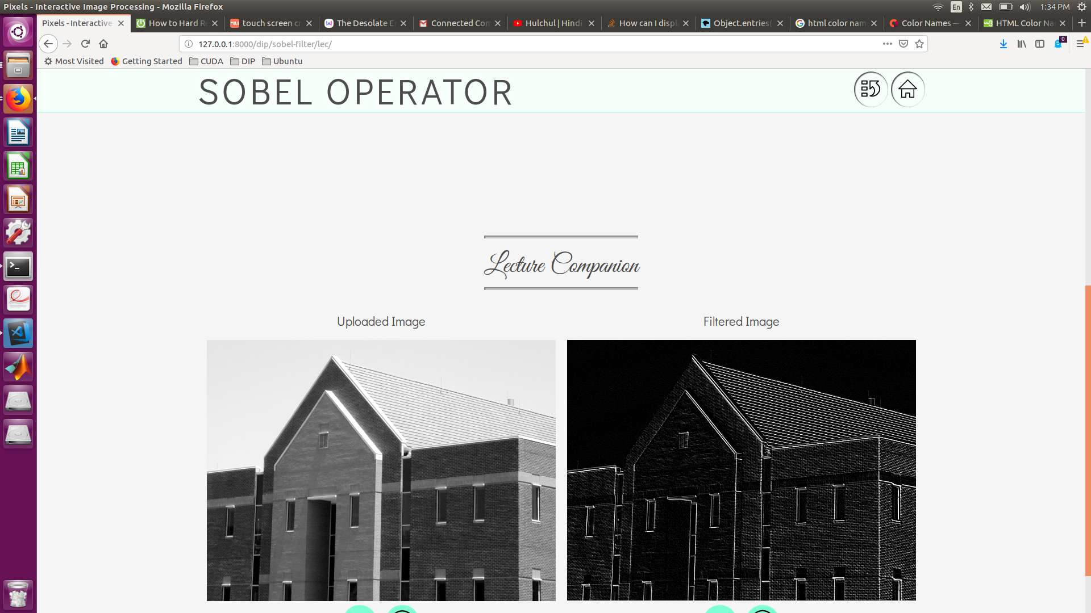

SOBEL: Diagonals

Slide 22
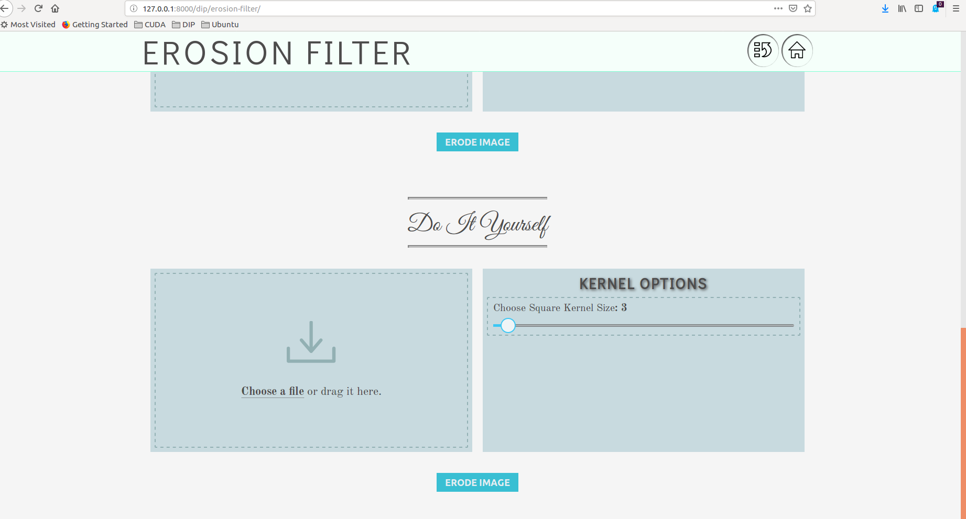
PIXELS: Erosion

Slide 23
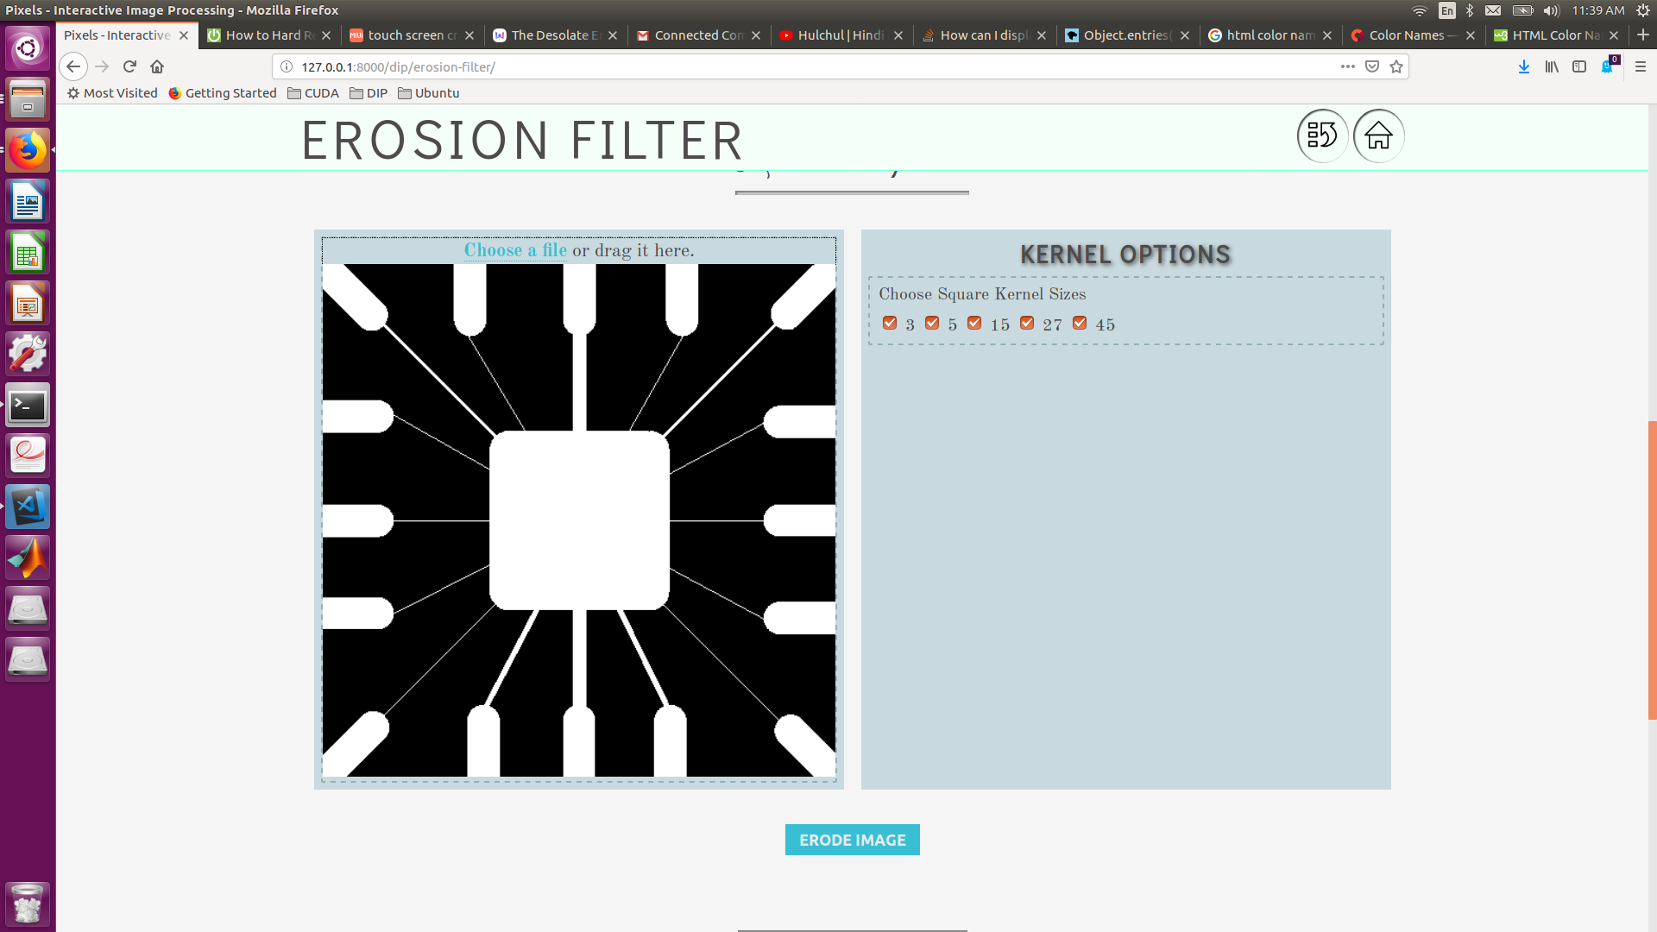
PIXELS: Erosion

Slide 24
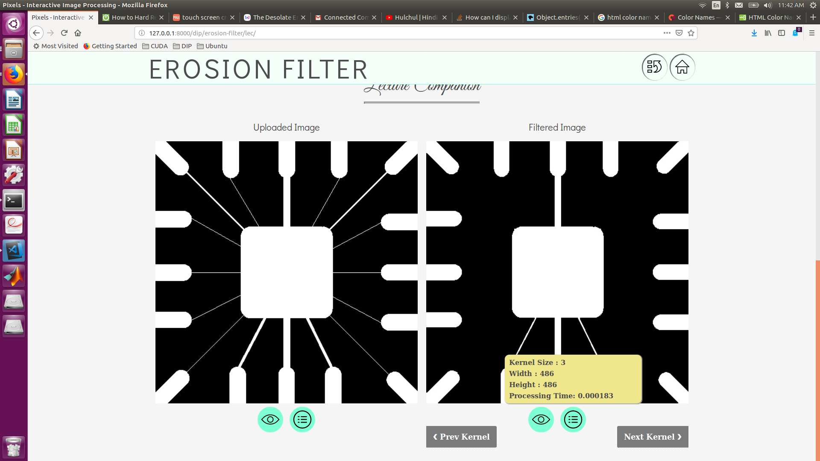
PIXELS: Erosion

Slide 25
Where Are We Going?
Addition of Theoretical Discussion
UX & UI Improvements
Implementation of More Techniques
Bug Fixes
Introduction of Playground Feature
PIXELS
Next Steps

Slide 26
PIXELS Demo The End

